Slide 1

Harmonizing Hit Predictions: Leveraging Audio Features to Forecast Spotify Top Songs.
Team A05
Dylan Kakkanad
Priyanka Chaudhari
Saachi Dholakia
Sahasra Konkala

Slide 2

k
Upgrade
Sahasra
Introduction
About Data
Pre Processing
Importance of This Analysis:
Model
Limitations
Strategic Release Tactics
Optimized Investment
Global Promotion
Enhanced User Recommendations
Play
Follow

Slide 3
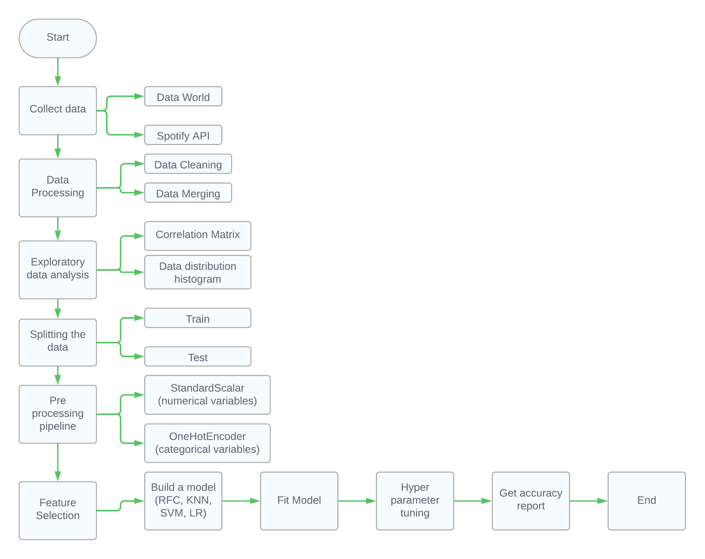

Sahasra
Introduction
Project Flowchart
About Data
Pre Processing
Model
Limitations

Slide 4
Dylan K
Introduction
About Data
Pre Processing
Data Description
Model
Limitations
Shape: 92233 Rows x 20 Columns
Overview of the Data
Highly Imbalanced on the target variable
Low Correlation between target variables and predictor variables.
Balance the Data
Using the Spotify API we pulled various playlists of popular songs.
We then extracted audio features of these songs by a second API call.
By adding more popular songs into our dataset we hoped to balance the data.

Slide 5
Data Cleaning
Dylan K
Introduction
About Data
Popularity was a continuous score ranging from 0-100. We chose a certain cutoff threshold to classify a song as popular or not popular.
Removed tracks with really low popularity score (0-10).
From the artists columns we create 2 new columns: Mult-artists and No of artists.
Drop Duplicate rows based on track_ids.
Set a cut-off threshold of 55 to classify songs equal to and above as popular and below as not popular
Pre Processing
Model
Limitations

Slide 6
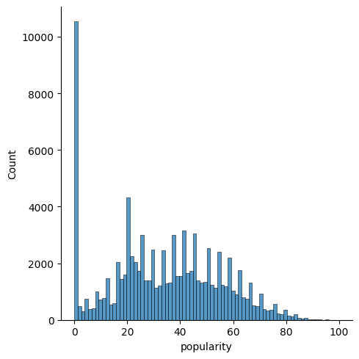
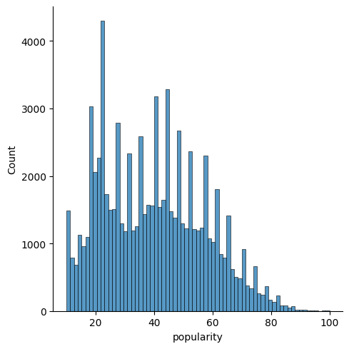
Distribution of Popularity
Dylan K
Introduction
Before Cleaning
After Cleaning
About Data
Pre Processing
Model
Limitations

Slide 7
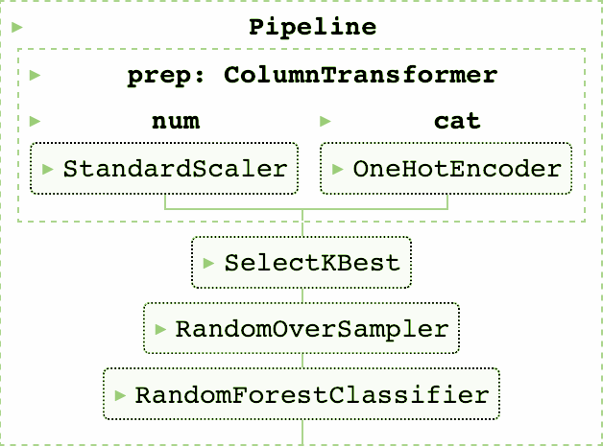
Upgrade
Priyanka
Introduction
Pipeline
About Data
Pre Processing
Model
Limitations

Slide 8
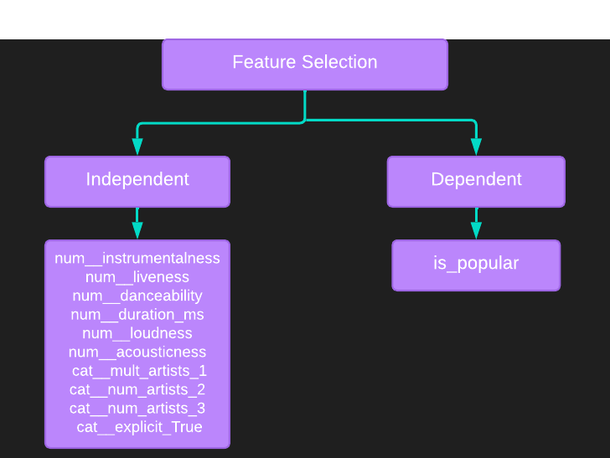
Upgrade
Priyanka
Introduction
Feature Selection
About Data
Pre Processing
Model
Limitations

Slide 9
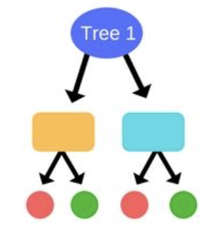
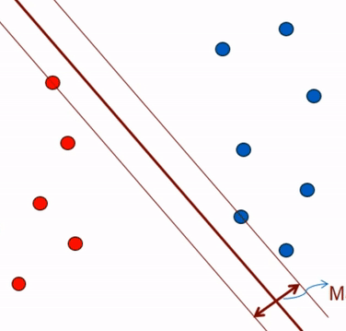
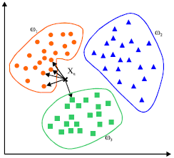
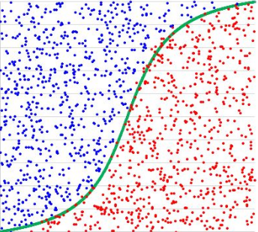
Upgrade
Priyanka
Introduction
Models
About Data
Pre Processing
Model
Limitations
RFC
SVC
KNN
Log Reg

Slide 10
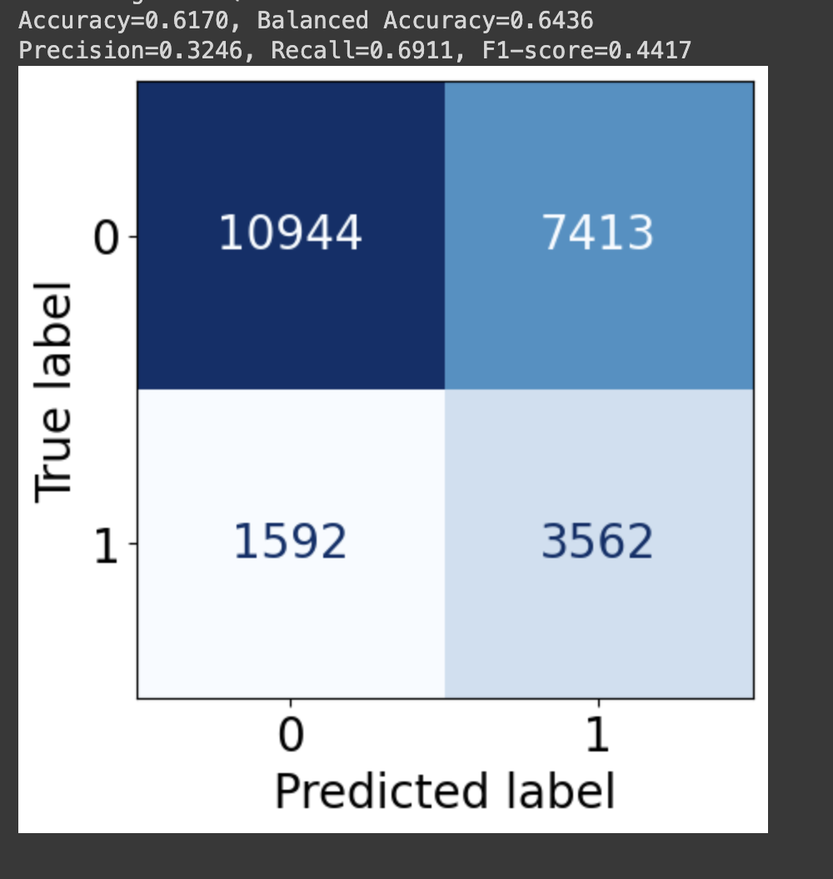
Upgrade
Priyanka
Introduction
Random Forest Classifier Model
About Data
Pre Processing
Model
Balanced Accuracy after Hyperparameter tuning
Instances of model correctly identifying songs and misclassification
Challenges
Limitations

Slide 11
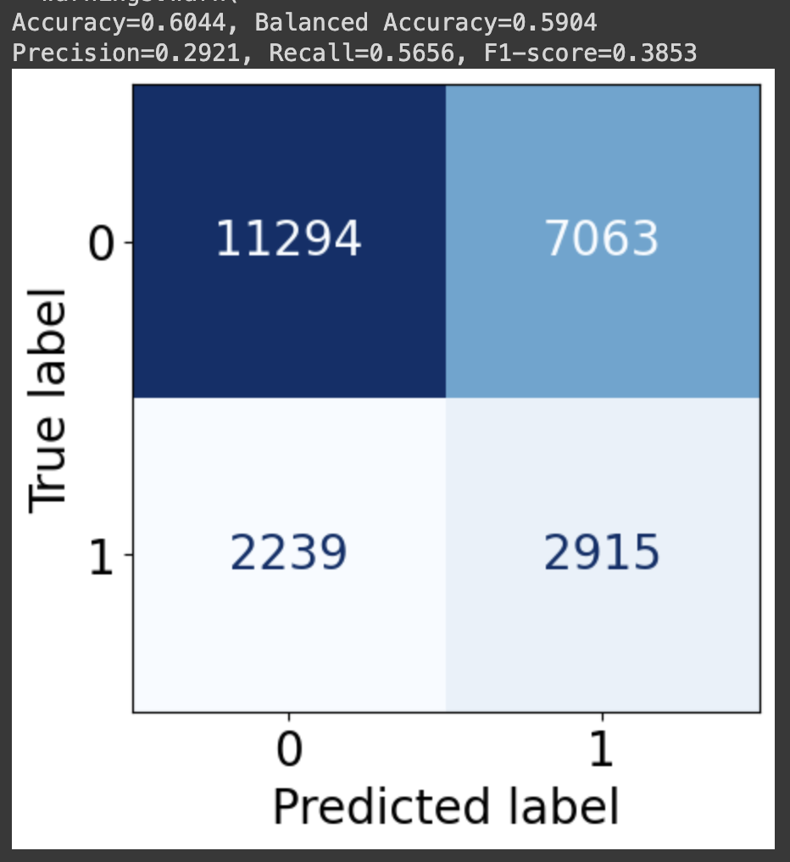
Upgrade
Saachi
Introduction
KNN Model
About Data
Pre Processing
Principle of Proximity
Before using Hyper Parameter Tuning
3 types of Hyper parameters used:
I. Grid Search
Ii. Halving Grid Search
Iii. Randomized Search
Model
Limitations

Slide 12
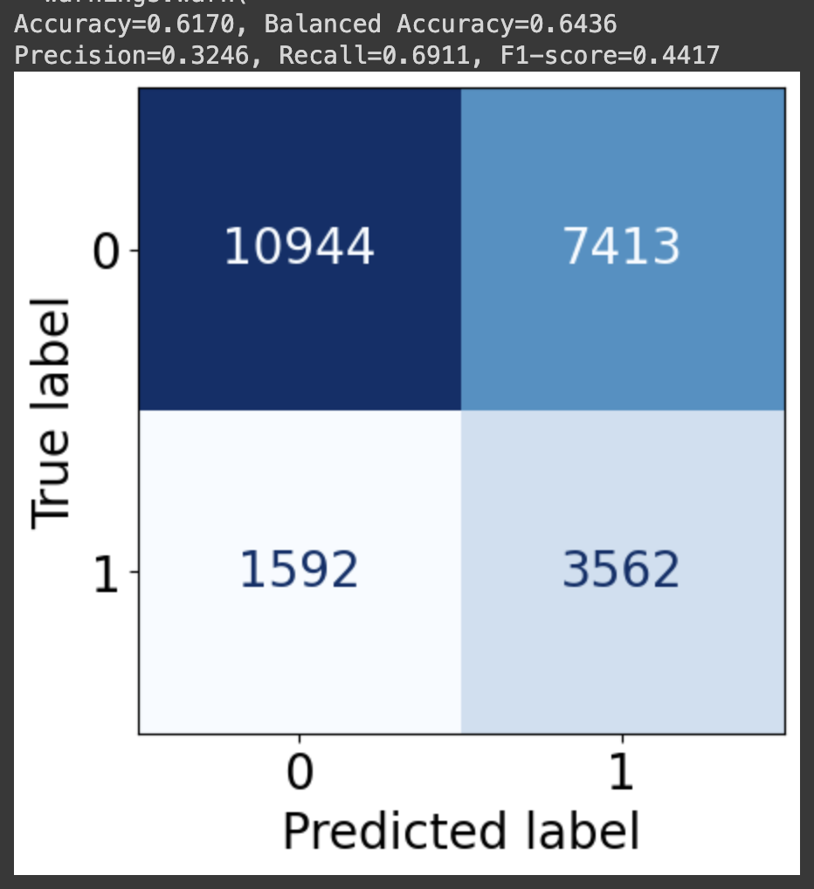
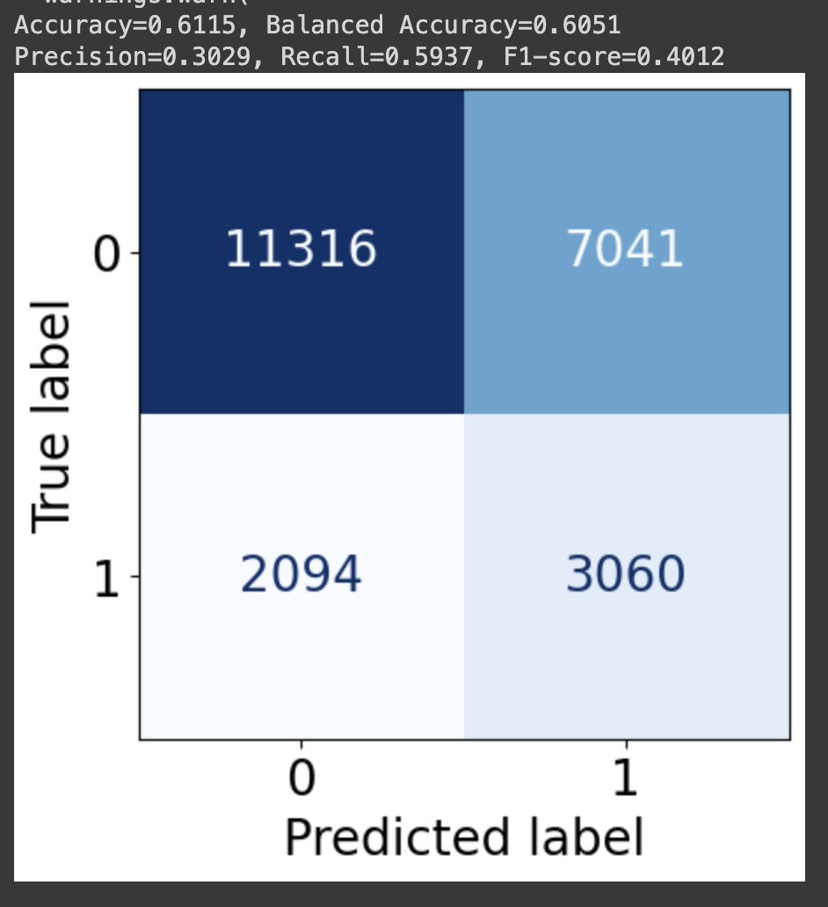
Upgrade
Saachi
Introduction
Hyper Parameter Tuning
About Data
Pre Processing
RFC - Halving Grid Search
KNN - Halving Grid Search
Model
Limitations

Slide 13

Upgrade
Saachi
Introduction
About Data
Pre Processing
Model Scores
Model
Limitations
Balanced Accuracy
Hyper Tuned Balanced Accuracy
#
Models
Accuracy
1
Random Forest Classifier
77.32%
58.56%
64.36%
2
K-Nearest Neighbour
60.44%
59.04%
60.51%
3
Logistic Regression
57.22%
60%
60%
4
Support Vector Classifier
55.89%
63.45%
63.45%

Slide 14
Upgrade
John Doe
Welcome
About Us
Our Teams
Limitations
Agenda
Limitations
01
Weak correlation of variables.
02
The absence of genre data (Herremans, 2014) limits insights.
03
Exclusion of external factors.

Slide 15


Thank You
Link to google colab https://colab.research.google.com/drive/17shSZtfZwrFMzsSofDNQWH9G_cW_xOcv?usp=sharing
Team 05
Harmonizing Hit Predictions
0:23
-3:25

